Slide 1

Exploratory Data Analysis
Analysis of a Renowned Football Player
- Dhruv Kumar

Slide 2

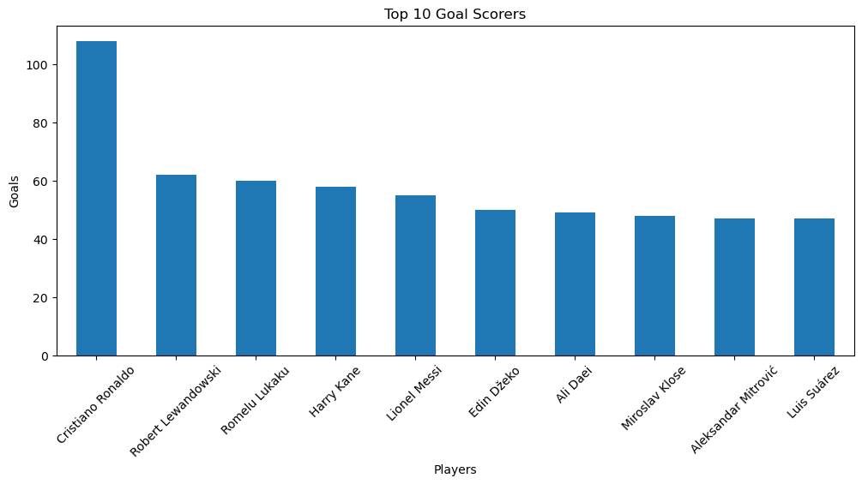
Top Goal Scorers
Interpretation
This graph highlights the top goal scorers in international football. Players with taller bars scored more goals, showing consistency and attacking strength.

Slide 3
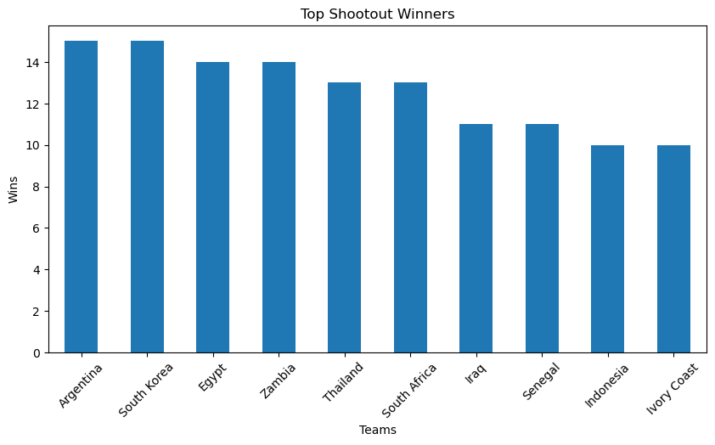
Top Shootout Winners
Interpretation
This visualization shows teams with the highest number of penalty shootout victories. Stronger performance under pressure can be observed here.

Slide 4
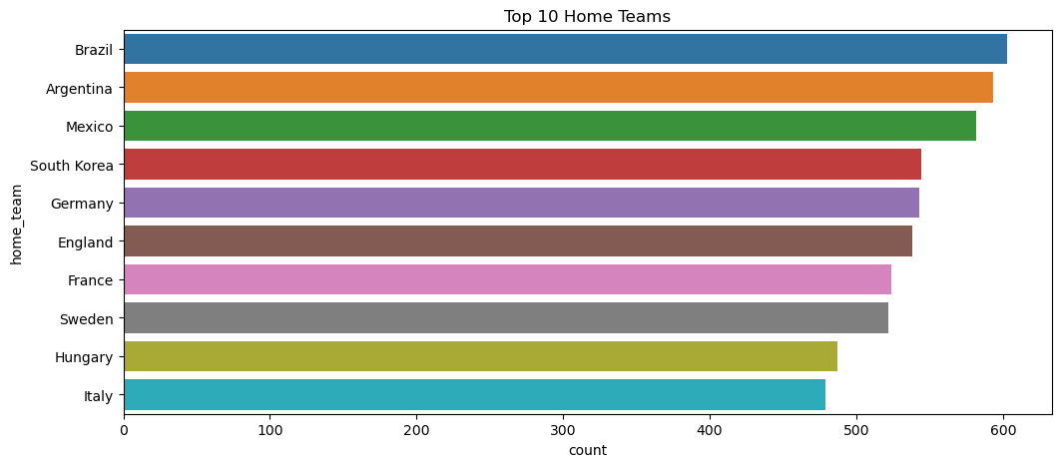
Top Home Teams
Interpretation
The graph displays home teams that played the maximum matches. It helps identify the most active football nations in hosting or playing games.

Slide 5
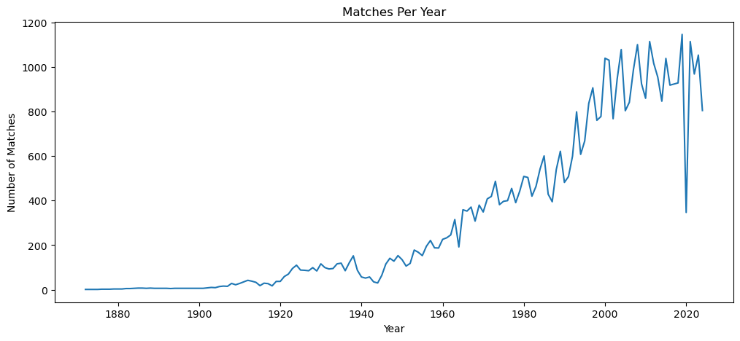
Matches Per Year
Interpretation
This yearly trend graph shows how football matches increased over time. Sudden drops may indicate global disruptions like wars or pandemics.

Slide 6
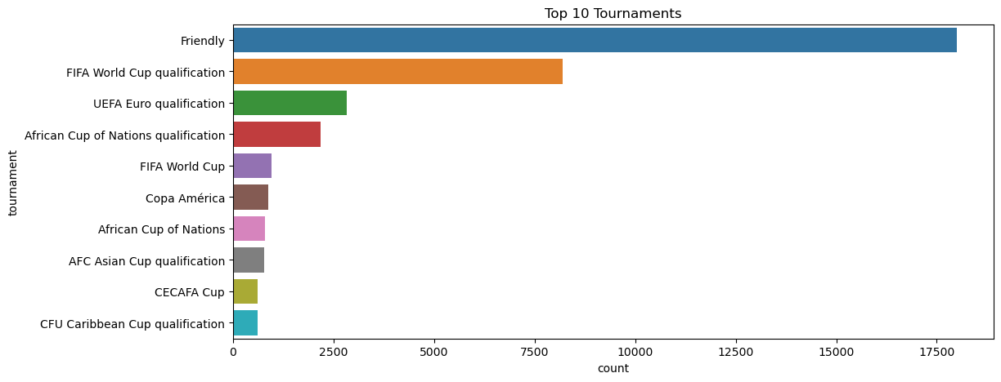
Top Tournaments
Interpretation
This chart represents the most frequently played football tournaments. Larger values indicate highly popular and recurring competitions.

Slide 7
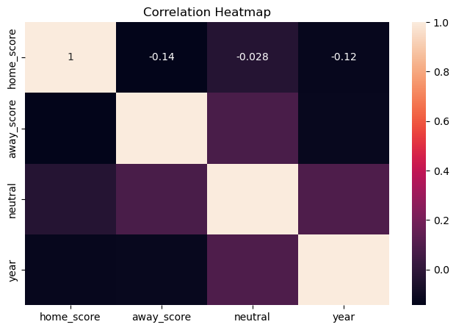
Correlation Heatmap
Interpretation
The heatmap shows correlations between numerical features. Darker colors and values close to 1 indicate stronger positive relationships.

Slide 8
Conclusion
This football EDA project provides meaningful insights through data visualization.
The graphs help understand player performance, tournament popularity, team activities, and statistical relationships.
Visual analysis makes complex football data easier to interpret.
-Thank You

